Slide 1
Lesson One Part Two
Food hygiene – why bother?

Slide 2

Discuss
How do bacteria and viruses get into our food?
Notes:
How do bacteria and viruses get into our food?
Bacteria live on foods we eat such as meat, poultry and fish and can also be found in raw milk, water and on raw vegetables.
Most of the pathogens that we ingest come from food, including animals, poultry, vegetables, water, shellfish and raw milk.

Slide 3
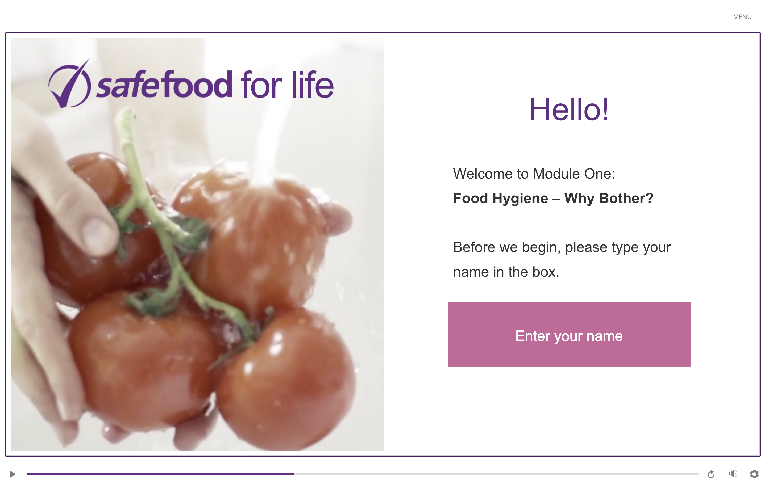
eLearning module

Slide 4
In class task
Invent a short funny sentence using the capital letters of the words in the list. For example, for the causes of food poisoning (Bacteria, Viruses, Chemical contaminants, Metals and Poisons), the short sentence could be Billy Vomits Constantly after Mouldy Pies.

Slide 5
Homework task
Find an example online of physical contamination of food.
  How did the physical contamination happen?
  What was the outcome?
  How could it have been prevented?

